Slide 1
AWS Storage: S3 and DynamoDB
CITS5503
Week 4
Dr. Anwarul Patwary

Slide 2
Storage in the cloud
You need to be able store data, images, videos, audio, source code, etc
We do that on computers and phones in a file system
Cloud services provide “buckets” to place “objects”
Largely data format agnostic
Objects have particular attributes

Slide 3
Objects
Have a unique id and a path to locate them
Have permissions applied as to who can list, read and write them
Have a type (audio, video, data, etc)
Have a life cycle: Creation, storage, deletion
Storage can be determined by nature of access: frequent vs rare

Slide 4
Amazon DynamoDB: NoSQL Database
Amazon DynamoDB is a document based key-value storage mechanism （与S3的区别）
Similar characteristics to S3 (plus services like Amazon Athena) in some ways
Mainly used to store documents rather than range of objects found in S3（与S3的区别）
Optimised and scalable for queries on large numbers of potentially unstructured documents.（与S3的区别）

Slide 5
AWS S3: Simple Storage Service
Objects stored in buckets
Object is data + metadata
Metadata is a set of name-value pairs that describe the object
Object is uniquely identified with a bucket by a key (name) and a version ID
Buckets
Organise the S3 namespace
Allow for access control
Unit of aggregation for usage reporting
Unique ID = bucket + key + version ID

Slide 6
Creating a bucket
Provide a unique bucket name
Select:
Region
Versioning
Server access logging
Tags
Object-level logging
Encryption
SSE-S3 (AES-256)
SSE-KMS

Slide 7
Creating a bucket (2)
Select Properties
Users with special permissions of Read and Write
Grant public read access to the bucket (Why is this a bad idea?)
Once created can manage
Lifecycle
Transition objects that are infrequently accessed (or after fixed time) to cold storage
Replication
Automatically copy objects to another bucket in a different region
Analytics
Suggest how to manage objects based on access patterns
Metrics
Stats on operations on objects in the bucket
Inventory
Provide a regular snapshot of contents of bucket

Slide 8
AWS S3 Regions
Region is chosen for performance (and data sovereignty)
S3 is a web store that provides “eventually consistent” guarantees
New objects
read-after-write
Synchronous store of data across multiple facilities （跨多个设施同步存储数据）
Updates and deletes could report old data if read before updates complete （最终一致性：如果在更新完成之前读取更新和删除可能会报告旧数据）
eventual consistency

Slide 9

S3: Versioning
S3 handles consistency through versioning rather than locking(S3通过版本控制而不是锁定来处理一致性)
The idea: every bucket + key maps to a list of versions
[bucket+key] → [object v1] [object v2] [object v3] …
Each time we PUT an object, it gets a new version
The last-received PUT overwrites any previous ones!
When we GET:
An unversioned request likely receives the last version – but this is not guaranteed depending on propagation delays
A request for bucket + key + version uniquely maps to a single object
Versioning can be enabled for each bucket
Why would you (not) want versioning?

Slide 10
Putting objects in buckets
S3 is not hierarchical : objects just go into buckets
However, can simulate hierarchy by using an object name constructed with a path
To copy a file using aws cli:
cits5503-students is the bucket
> aws s3 cp afile.txt s3://cits5503-students/123456/folder1/folder2/afile.txt

Slide 11
S3: Permissions and Policy (1)
Why is this important? S3 buckets left open to public:（为什么重要）
Nov 2017 Contractor exposes personally identifiable data from 50,000 Australians (AMP, UGL, Rabobank)
Nov 2017 Accenture leaked corporate information
Alteryx exposes data on 120 million US households
March 2018 Medical Data of 33,000 patients
Interesting to consider if this is a failure of the users or the system
Too complex?

Slide 12
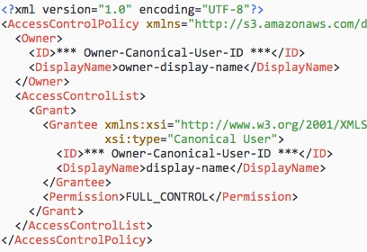
S3: Permissions and Policy (2)
Access to S3 buckets and objects controlled by:
User policies
Bucket policy
Bucket ACL (Access Control List)
Object ACL
ACL
Buckets and Objects can have ACLs
ACLs grant Read/Write permissions to specific AWS users
Bucket and Object Policies
Specified in JSON
Applies to IAM and AWS users and Anonymous (Public) access

Slide 13
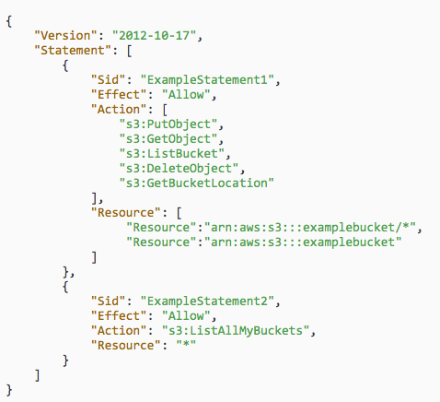
S3: Permissions and Policy (3)
User Policy attached to IAM user, group or role
Gives access of a particular kind to a particular resource

Slide 14

Data Encryption
Server-side or Client-side
Client-side encryption handled by user
Server-Side
Can use AWS Key Management Service (AWS KMS)
Handles key generation, key lifecycle
Audit key usage
Using encryption is seamless – specify encryption at the bucket or object level using KMS keys
More control if needed

Slide 15
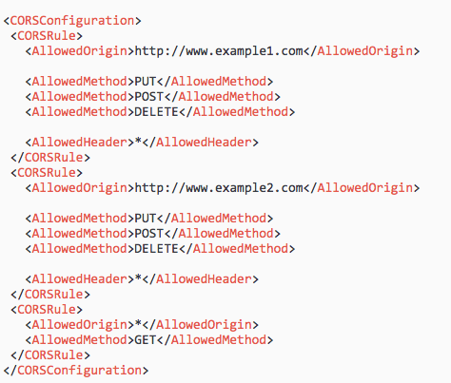
AWS S3 CORS
Cross-origin Resource Sharing（跨域资源共享）
If your web application uses files (like CSS or Javascript) stored in S3, need a CORS configuration
Allows web applications in one domain to interact with files in another

Slide 16
AWS S3 Other Features
Can enable BitTorrent access to files
Torrent file is accessed using ?torrent on the end of the object URL
Can enable payment for files stored on S3 using Amazon DevPay
Can enable logging of access

Slide 17
AWS Athena (使用SQL查S3数据，日志必备)
Service that allows you to write SQL queries for S3 data
Uses
Presto – a distributed SQL engine to run queries
Apache Hive to create, drop and alter tables and partitions
Very good for reviewing logs of other applications

Slide 18
AWS Athena: CloudTrail
CloudTrail logs all API calls on AWS and shows details of user, what they called, where they called from etc.
1st Step is to create a Trail in CloudTrail – saves log files in a particular location in S3
2nd Step is to create a table that is the data structure of the log

Slide 19
CREATE EXTERNAL TABLE cloudtrail_logs (
eventversion STRING,
useridentity STRUCT< type:STRING,
principalid:STRING,
arn:STRING,
accountid:STRING,
invokedby:STRING,
accesskeyid:STRING,
userName:STRING,
sessioncontext:STRUCT< attributes:STRUCT< mfaauthenticated:STRING,
…
)
ROW FORMAT SERDE 'com.amazon.emr.hive.serde.CloudTrailSerde' STORED AS INPUTFORMAT 'com.amazon.emr.cloudtrail.CloudTrailInputFormat' OUTPUTFORMAT 'org.apache.hadoop.hive.ql.io.HiveIgnoreKeyTextOutputFormat' LOCATION “s3 location of log”

Slide 20
Queries
Can now create queries like:
SELECT useridentity.arn,
eventname,
sourceipaddress,
eventtime
FROM cloudtrail_logs
WHERE useridentity.arn LIKE ‘%@student.uwa.edu.au%’
and eventname = 'RunInstances’ ;

Slide 21
AWS DynamoDB: Record-Like Key-Value Storage

Slide 22
What is Amazon DynamoDB?
A NoSQL “database”
A highly scalable, non-relational data store
Despite its name, not really a database
Stronger consistency guarantees than S3（比S3更强的一致性保证）
Highly scalable; built-in replication; automatic indexing（可伸缩 可复制 可索引）
No 'real' transactions, just a conditional put/delete
No 'real' relations and joins, just a fairly basic select

Slide 23
Core Components
Tables
Collection of data (e.g. representing entities): People
Schemaless
Items
Group of attributes that is uniquely identifiable
Person in People table
Physically a JSON document
Atrributes
Fundamental data element
Limited types of data: Scalar, Document, Sets
LastName in Person item
One or more attributes make a primary key (unique)

Slide 24
Keys and Indexes
Partition key（分区键）
Single primary key of one attribute
Key is unique and is hashed to determine physical partition data resides in
Partition key and sort key
Composite primary key composed of two attributes
First attribute is the partition key, the second is the sort key
Partition key is hashed → partition, data is stored sorted by the sort key
Global secondary index
Index with a partition key and sort key that is different to the table’s partition and sort keys
Local secondary index
Partition key is the same as for the table, sort key is different

Slide 25
DynamoDB API
Control Plane
Operations on tables
CreateTable, DescribeTable, ListTables, UpdateTable, DeleteTable
Data Plane
Create, Retrieve, Update and Delete operations
PutItem: specify primary key and optionally other attributes
GetItem: Retrieve single item using primary key
Query: Retrieve all items with partition key optionally sorted
Scan: Retrieves all items in a specified table
UpdateItem, DeleteItem as the names suggest

Slide 26
DynamoDB Data Model
Key
Name (hash key)
Range
Attributes (key-multivalue)
CustomerID | Date | First name | Last name | Street address | City | State | Postcode | Email
123 | 1/2/3 | Bob | Smith | 123 Main St | Perth | WA | 6000
123 | 2/3/4 | Bob | Smith | 123 Main St | Sydney | NSW | 2000
456 |  | James | Johnson | 456 Front St | Melbourne | Vic | 3000 | james@foo.com
Items
Somewhat analogous to a spreadsheet:
Domains: Entire 'tables'; like buckets
Items: Names with attribute-multivalue sets
For example, an item could have more than one street address
It is possible to add attributes later
No pre-defined schema

Slide 27
Data Types
Attributes can be:
Scalar Types
Number, String, Binary, Boolean, null
Document Types
Lists e.g. FavoriteThings: ["Cookies", "Coffee", 3.14159]
Map – Key Value Pairs
Set Types
Array of the same type
["Black", "Green" ,"Red"]
[42.2, -19, 7.5, 3.14]

Slide 28
Read Consistency
Reads from DynamoDB can be either:
Eventually Consistent Reads
Data from a write may not be available straight away
Strongly Consistent Reads
Reads return most up-to-date information reflecting all updates from write operations
Throughput capacity
When creating a table, specify the
read capacity unit = number of strongly consistent reads per second (1) or eventually consistent reads (2) per second for items up to 4KB – larger items need more capacity
Write capacity unit = number of writes of 1 KB in a second
Can Auto Scale

Slide 29
Partitioning
DynamoDB automatically handles partitioning across availability zones within a region
Partitions are accessed through the partition key

Slide 30
Example
Setting up a local DynamoDB
From a terminal:
mkdir dynamodb; cd dynamodb
install jre if not done (sudo apt-get install default-jre)
wget https://s3-ap-northeast-1.amazonaws.com/dynamodb-local-tokyo/dynamodb_local_latest.tar.gz
java -Djava.library.path=./DynamoDBLocal_lib -jar DynamoDBLocal.jar –sharedDb
Start a new terminal

Slide 31
Create Table
aws dynamodb create-table --table-name Music
--attribute-definitions \
AttributeName=Artist,AttributeType=S \
AttributeName=SongTitle,AttributeType=S
--key-schema AttributeName=Artist,KeyType=HASH \
AttributeName=SongTitle,KeyType=RANGE \
--provisioned-throughput ReadCapacityUnits=1,WriteCapacityUnits=1 \
--endpoint-url=http://localhost:8000
aws dynamodb scan --table-name Music \
--endpoint-url=http://localhost:8000

Slide 32
Create Entries
aws dynamodb put-item \
--table-name Music \
--item \ '{"Artist": {"S": "No One You Know"}, "SongTitle": {"S": "Call Me Today"},
"AlbumTitle": {"S": "Somewhat Famous"}}’ \
--return-consumed-capacity TOTAL --endpoint-url=http://localhost:8000
aws dynamodb put-item \
--table-name Music \
--item '{"Artist": {"S": "Acme Band"}, "SongTitle": {"S": "Happy Day"}, \
"AlbumTitle": {"S": "Songs About Life"} }’ \
--return-consumed-capacity TOTAL --endpoint-url=http://localhost:8000
aws dynamodb scan --table-name Music \
--endpoint-url=http://localhost:8000

Slide 33
Query
{ "Artist": { "AttributeValueList": [{ "S": "No One You Know" } ],
"ComparisonOperator": "EQ"
},
"SongTitle": { "AttributeValueList": [{ "S": "Call Me Today" } ],
"ComparisonOperator": "EQ"
}
}
aws dynamodb query --table-name Music --key-conditions= file://key-conditions.json \
--endpoint-url=http://localhost:8000

